Slide 1


The Public Utility Data Liberation (PUDL) Project
US FUEL RECEIPTS ANALYSIS
FUNDAMENTALS IN MACHINE LEARNING - FINAL PROJECT
SHIVA CHAITANYA GOUD GADILA

Slide 2

PROBLEM-research based analysis
Problem:-To find out which Natural Resource is demanded the most in order to generate power in the USA?
I am using the EIA-923 Schedule 2, Part A dataset, which contains information on fuel generation and importation.
I observed that there is a large amount of fuel being imported, and the prices do not always follow the typical market trends expected in a country like the US, which values economic stability.
To focus our presentation, we are placing more emphasis on the categorical data rather than the numeric variables.

Slide 3


DATA DESCRIPTION
We are making use of a dataset called Fuel Cost Receipts, which can be found in the EIA-923 Schedule 2, Part A. This dataset contains data on how much fuel costs in the United States for power generation.
DATA PARTITION divided our dataset into a training set of 75% and a test set of 25%. This allowed us to train our models on a subset of the data and test their performance on unseen data.
DATA NORMALIZATION- I used Z-score normalization on our data. This method rescales the data to have a mean of zero and a standard deviation of one, making it easier to compare and analyze different variables
Cluster: K-means clustering algorithm to group our data into distinct clusters
Clean dataset, no duplicates or missing values.
Statistics show fuel and mine sources.
We will segment the data into smaller random samples for ease of analysis.

Slide 4
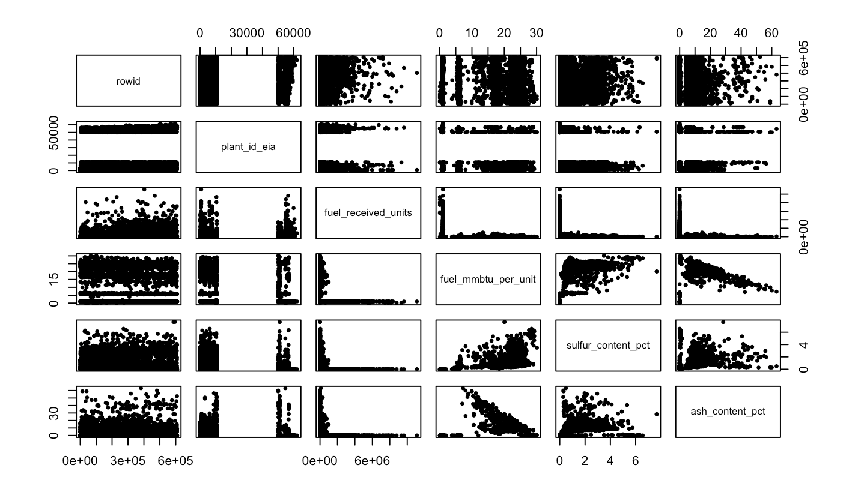

ANALYSIS
I Observed fuel import and usage ratio data shows significant variance, possibly due to fluctuating demand, changing prices, or other factors.
Ash content has a significant impact on cluster formation during fuel usage analysis. Clustering analysis has the potential to influence the fuel's performance and combustion by bringing together related data points.
I used the z-score method to normalize the data and analyse how and where the clusters are formed, but since we have more categorical analyses, a theory-based analysis is what I understood to be the impact it has on the environment and the import and export of fuel.

Slide 5
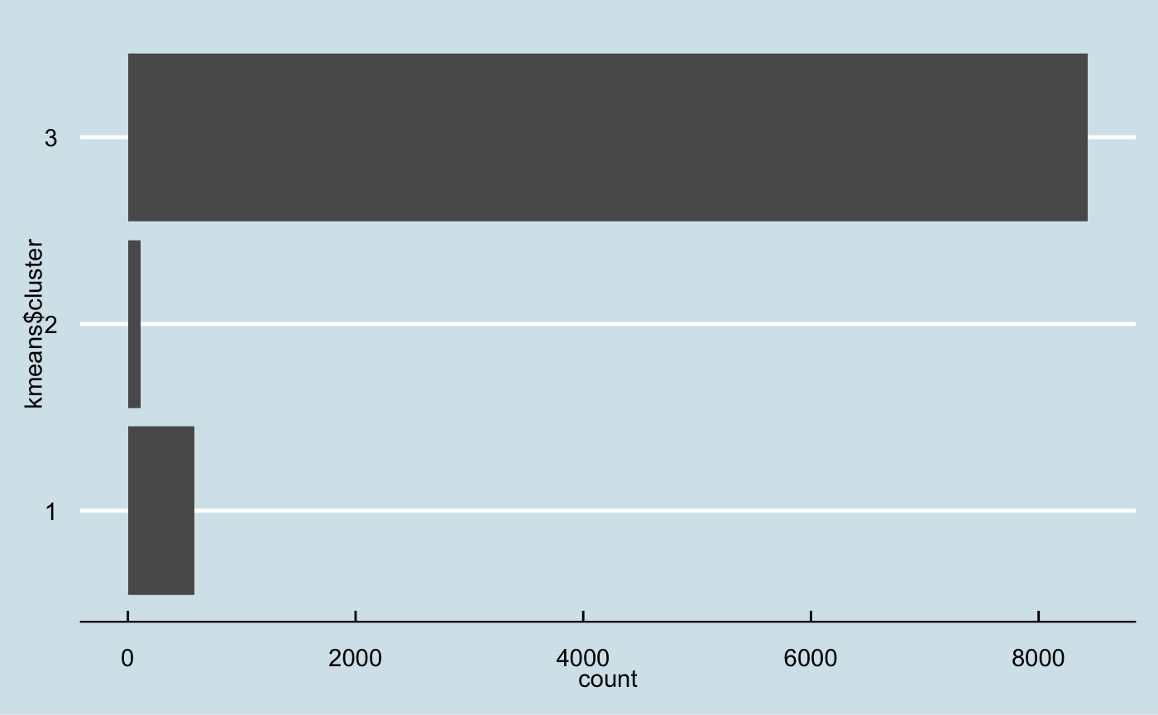

DISCUSSION
As the incombustible component that remains after a sample of the furnace oil has been completely burned, I have analyzed the data using the ash content of the fuel per one million British Thermal Units.
When the ash content is high in fuel, it indicates that there is a lower amount of volatile matter present.
Among the given data, ash content has the highest value while sulfur and mercury have the lowest.
It is crucial to determine the amount of combustible fuel that can be obtained.
The data points are divided into three clusters based on the distance between their ash content values.

Slide 6

Conclusion
Cluster 1 has the most MMBtu and has the potential to supply the automotive industry with the most energy.
In the USA, quality is profoundly esteemed, and individuals favour the best quality at a sensible value, which is coal.
As a result, there would be a high demand for coal in comparison to other resources.
Renewable energy sources are dependent on fossil fuels, as materials derived from petrochemicals are crucial for producing solar panels, wind turbines, and batteries. Thus, reducing energy consumption is critical for controlling costs and minimizing environmental impact.

